Slide 1
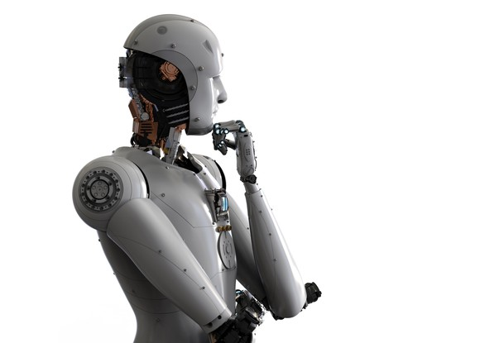

Marketing Plan – Phase 1
Vishwanath Akuthota

Slide 2

Who am I?
IBM Watson cognitive super computer which is designed by IBM.
Watson was named after IBM's first CEO, industrialist Thomas J. Watson.
It is question answering system which is designed with natural learning process and deepQA
The computer system was specifically developed to answer questions on the quiz show Jeopardy! in 2011.
It is designed to learn as human and think as human in solving todays problems in data analytics.
It can be served as virtual assistant in any filed like technology, health care, food business and many more.

Slide 3

Market Definition (what I do)
IBM Watson is virtual assistant which can be build by with no coding.
Watson is a digital marketing automation platform designed to put the power of data in the hands of the marketer.
Use behavioral data from any source to create consistent campaigns wherever your customers are through channels like email, web, mobile apps, SMS, social, group messaging and more.
- Virtual assistant
- Campaign automation
- Customer journey building
- empowering to create consistent personalized engagements
- create marketing strategies
It’s competitors are start ups in cognitive computing.

Slide 4

Market Demand
Total Average revenue of IBM $79.9 billion.
The percentage of cognitive computing IBM Watson is 35% which is 27.96 billion.

Slide 5
Market Potential
Market potential = maximum consumer units X buying ceiling X purchase rate X purchase quantity X average price
Market potential = 1,1175,380,000(potential market size with 10 departments)* 35%(share of potential market) * 411,383,000(No of sales in 10 departments) * 100(product price therefore manufacturing cost $20)* $2(royalty payment per unit of 10% of $20) = 822,7666,000 billions
The 10 departments in an industry are IT, customer service, operations, corporate strategy & management, finance, human resources, product development, communications/PR, sales, marketing.

Slide 6
Market Development index
MDI= Market Demand/ Market Potential * 100
(27,900,000,000/82,276,600,000) * 100 = 34
Well MDI is 34 which implies addressing benefits deficiencies and reducing prices.

Slide 7
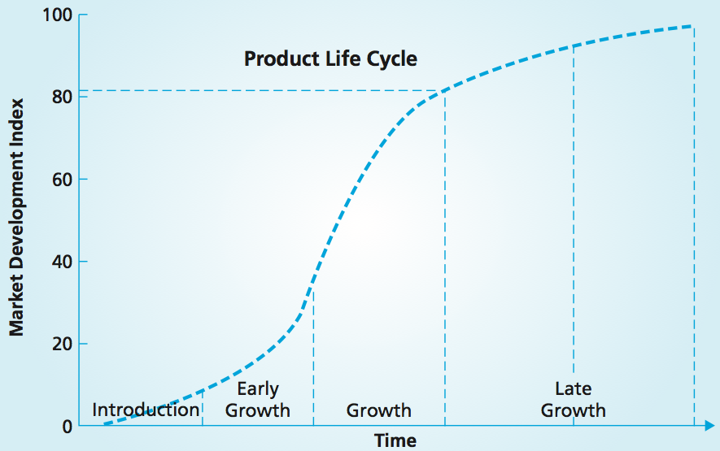
Product Lifecycle
Being that MDI value of IBM Watson is 34 that means it is to enter into growth.
That means it has to reduce its prices and address its benefits.
High MDI
Moderate MDI
IBM Watson
Low MDI

Slide 8
Market Growth
Product forces | Relative importance % | Customer rating
Advantage | 30 | 10
Affordable | 15 | 5
Ease of use | 25 | 9
Performance | 20 | 9
Available | 10 | 5
Total | 100 | 7.6
Customer forces | Relative importance % | Customer rating
Need | 40 | 9
Risk | 7 | 6
Buying | 20 | 5
Observation | 13 | 8
Trial | 20 | 8
Total | 100 | 7.2
Current customers: Innovators/ Early adopters
Product availability should be convenient and affordable.

Slide 9
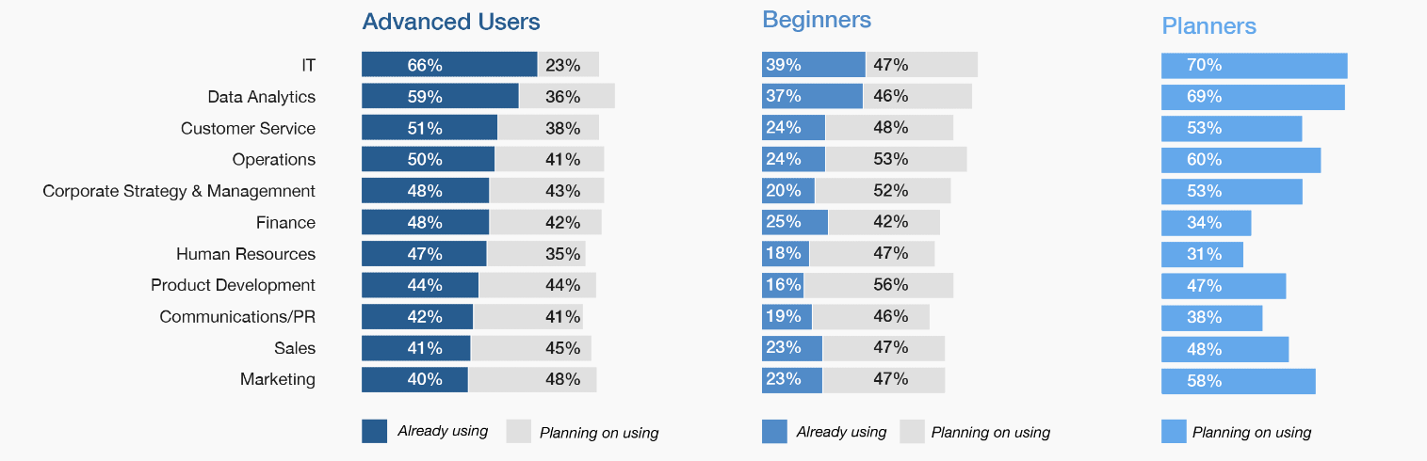
Market Growth
Beginners 54%
Advanced users 22%
Planners 24%

Slide 10
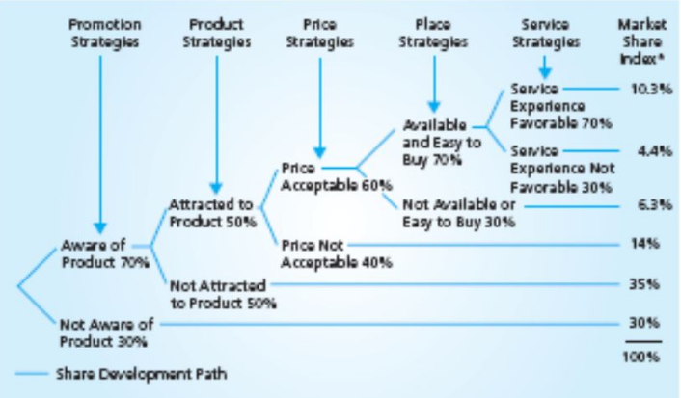
Market Share
Market share index is 10.3%

Slide 11
Summary
From the above market development index and market share index the growth opportunity is more than 70%.
From enhancing customer relationships to greater efficiency to business growth.
Almost half of users report cab improve customer service (for example, better self-service or agents armed with more timely and accurate intelligence) as well as personalized customer experience (for example, through targeted recommendations and offers) as their top outcomes. For advanced users, the gains in customer engagement and the ability to respond faster to market needs were nearly doubled compared to beginners.

Slide 12
Summary
Improved productivity and efficiency is just as significant an outcome, and cost remains a key consideration as organizations embark on cognitive initiatives.
Users also leverage cognitive technology to improve learning experiences by supporting the development of new educational tools and customized programs for students, employees and customers. Here again, advanced users are twice as likely to achieve these outcomes as their beginner counterparts.
While making strides in customer-centric or operational goals can be transformational on their own, cognitive users have an eye on growth-oriented outcomes such as expanding their ecosystem or growing the business in new markets—outcomes which may take center stage as cognitive adoption matures.

Slide 13
References
https://www.ibm.com/watson/advantage-reports/market-report.html
https://channels.theinnovationenterprise.com/articles/watson-faces-tough-competition-from-startups-in-cognitive-computing
https://www.fool.com/investing/2017/08/30/ibm-watson-everything-you-ever-wanted-to-know.aspx
https://www.cnbc.com/2017/06/16/ai-assault-on-stock-market-ibms-watson-is-getting-into-etf-business.html
https://discovery.hgdata.com/product/ibm-watson

